Slide 1

Department of Computer Science & Engineering Mammary Carcinoma Batch no. 39 1. 2211CS010363 (M. Bhargav) 2. 2211CS010459 (P. Charan sai) 3. 2211CS010404 (N. Uday Kumar) 4. 2211CS010514 (S. Harsha Vardhan) Guide Mr. G. Raju
Maisammaguda, Kompally, Medchal - Malkajgiri District Hyderabad - 500100, Telangana State. www.mallareddyuniversity.
(Telangana State Private Universities Act No. 13 of 2020 &
G.O.Ms. No. 14, Higher Education (UE) Department)

Slide 2
Table of Contents
Abstract
Introduction
Limitations of Existing Systems
Methodology (Architectural/Workflow Diagram)
Screenshots of Working model
Conclusion
References

Slide 3
Abstract
Breast cancer is one of the most common forms of cancer among women, and early detection plays a critical role in improving survival rates. This project focuses on leveraging data analytics to enhance understanding, diagnosis, and treatment of breast cancer. Utilizing a dataset comprising patient blood cell attribute’s such as mean radius, perimeter etc, we apply machine learning techniques and statistical analyses to identify patterns and key indicators associated with breast cancer. The project involves preprocessing and cleaning the dataset, feature selection to identify significant variables, and building predictive models to classify malignant and benign cases with high accuracy. Advanced visualization techniques are used to explore the relationships between clinical features such as tumor size, texture, and shape.

Slide 4
Introduction
This project focuses on analyzing breast cancer datasets to identify key patterns, correlations, and trends. By leveraging data analytics techniques such as statistical analysis, visualization, and predictive modeling, we aim to extract meaningful insights from patient records, biopsy results, and tumor characteristics.
Despite significant advancements in early detection and treatment, breast cancer is still one of the leading causes of cancer-related deaths among women. The challenge in early diagnosis lies in the complexity of the disease itself, as tumors can vary widely in size, shape, and behavior. Additionally, breast cancer can manifest in different forms, making it crucial for healthcare professionals to have advanced tools that can provide more accurate, timely diagnoses.

Slide 5
LIMITATIONS OF EXISTING ALGORITHMS
Incomplete or Missing Data: Patient records may have missing values for important attributes like radius, texture, perimeter etc.
Poor User Interface: Doctors and healthcare professionals may find existing systems difficult to use.
Slow Data Processing: Existing systems may not process large datasets efficiently,
causing delays in diagnosis.
Overfitting: AI/ML models may perform well on training data but fail in real-world clinical
applications.

Slide 6
Proposed Methodology
Problem Definition
Data Collection
Data Preprocessing & Cleaning
Exploratory Data Analysis (EDA)
Model Development
Deployment & Interpretation
Conclusion & Future Work

Slide 7
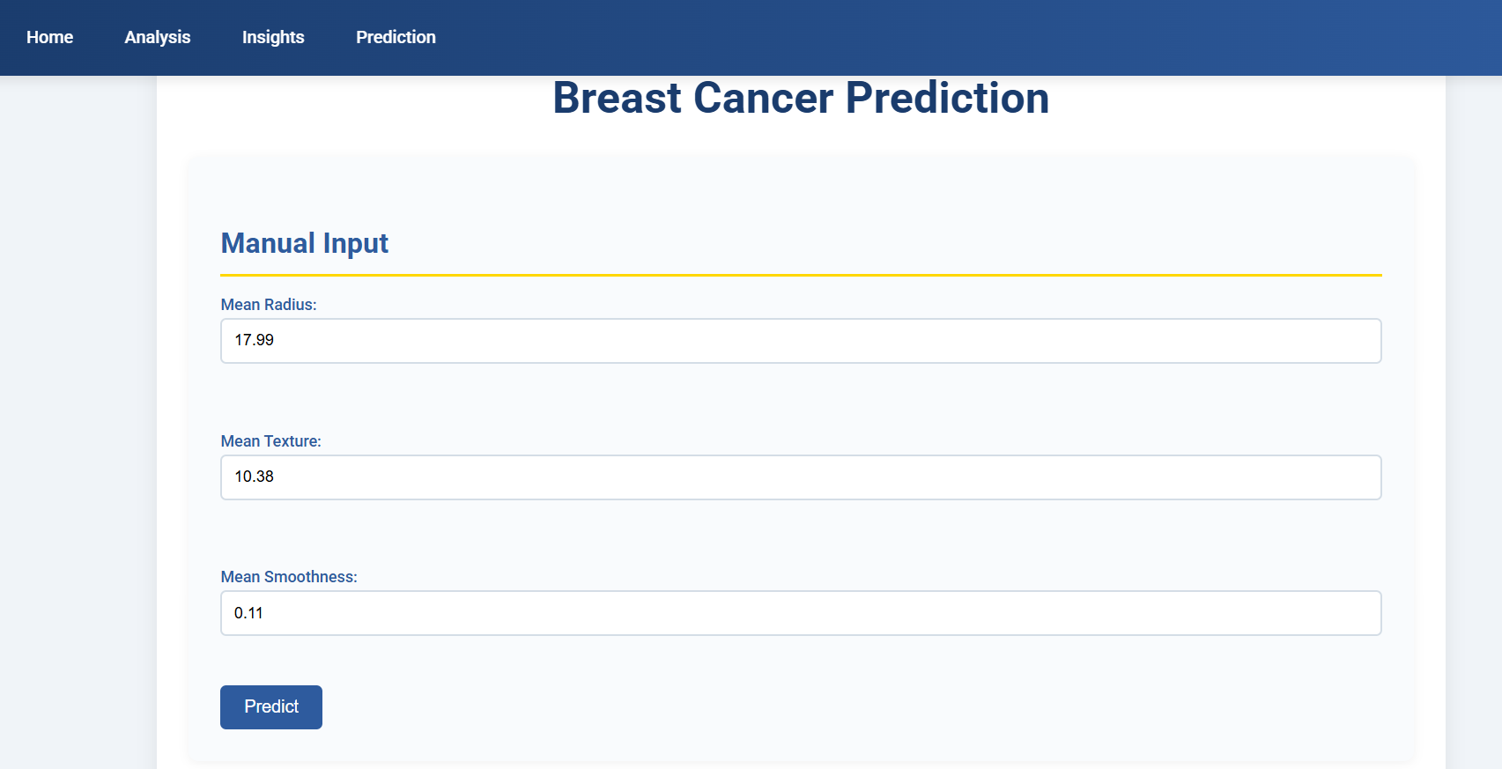
Screenshots
Fig1: Prediction Page

Slide 8
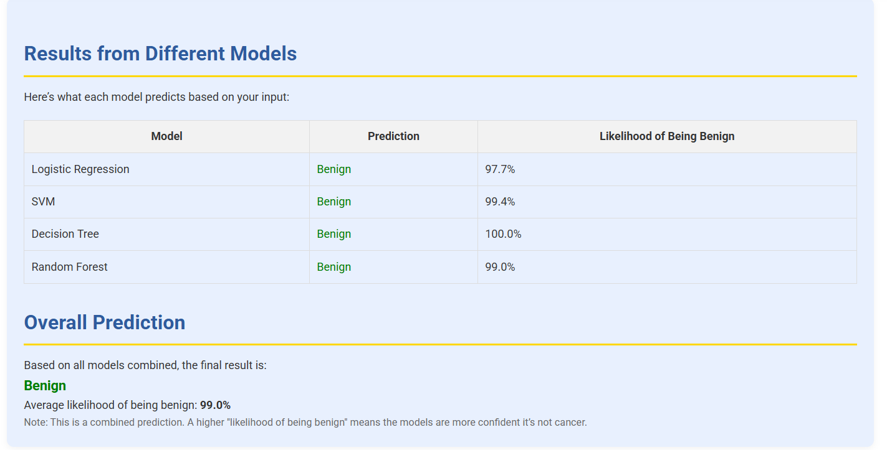
Fig2 : Overall Prediction

Slide 9
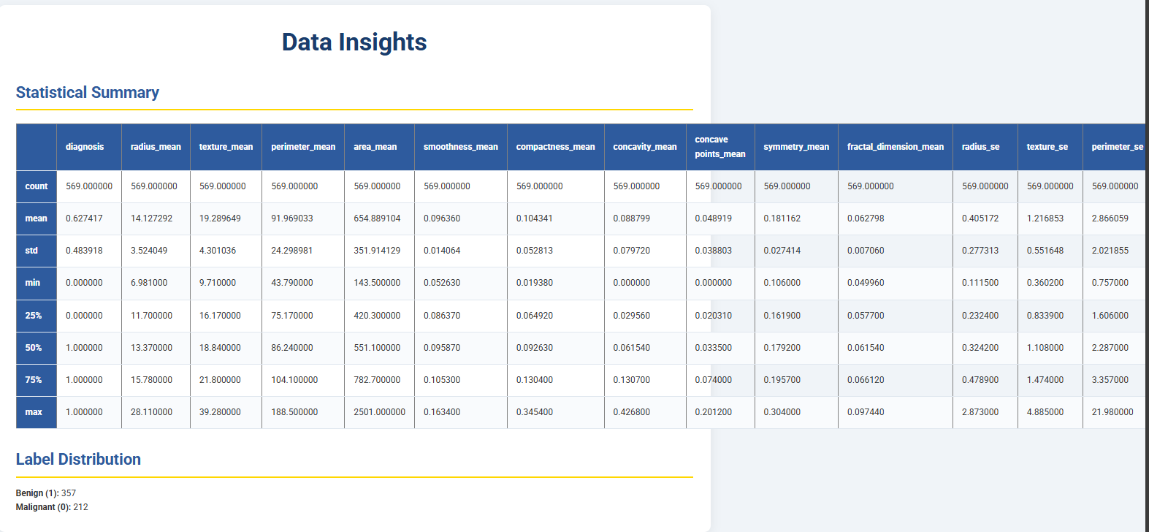
Fig 3: Insights Page

Slide 10
Conclusion
In conclusion, this project has explored the potential of using machine learning and data analytics to predict breast cancer outcomes, focusing on the prediction of whether a tumor is benign or malignant. By utilizing various machine learning techniques such as logistic regression, decision trees, and support vector machines (SVM) and Random Forest. This project has demonstrated that AI models can offer valuable insights for early detection, significantly enhancing the ability to diagnose breast cancer at earlier stages, thereby improving the chances of successful treatment and survival.

Slide 11
References
Ahmad, M., & Yaseen, M. (2020). Predicting Breast Cancer using Machine Learning Algorithms: A Survey of Techniques. Journal of Computational Science, 38, 101047.
Delen, D., & Crossland, M. D. (2013). Predicting Breast Cancer Survivability: A Comparison of Machine Learning Techniques. Expert Systems with Applications, 40(10), 4342-4350.
Sun, J., & Wang, J. (2019). Predicting Breast Cancer Recurrence Using Machine Learning Algorithms. Computers in Biology and Medicine, 118, 103613.
Rahman, S., & Ahsan, M. (2017). Predicting Breast Cancer Using Machine Learning Techniques: A Comparative Study. International Journal of Machine Learning and Computing, 7(5), 132-136.

